Slide 1
FIND TRAVEL INSURANCE PLAN FOR STUDENTS
TEAM MEMEBERS:
Nithya Shree Balakrishnan- 910649
Karthikeyan Rajan - 910654
Lekha Martina Gananaprakasam - 910602
Nithisha Pappusamy - 910647
Prakash Palanisamy - 910643

Slide 2
CONTENTS
Problem Statement and Detailed Description
Landing page of policy Bazaar
Travel Insurance Page
Car Insurance Page
Health Insurance Page
Test Data
Output from Console
Report
Functional Test cases

Slide 3
Problem Statement :
Display three lowest international travel insurance plan with amount and insurance provider company
Group of 2 student people (Age 22,21)
For any European country.
(Suggested Site: policybazaar.com however you are free to use any other legitimate site)
Detailed Description:
Find travel insurance plan for students, for 2 people (Age 22 & 21) & any European country, fill further dummy details & display three lowest international travel insurance plan with amount and insurance provider company
Get a Car Insurance quote, proceed without car number, keep filling details, give invalid email or phone number & capture the error message
Retrieve all Health Insurance menu items and store in a List; Display the same

Slide 4






Website we used https://www.policybazaar.com/
Tools and Software’s used:

Slide 5
WORK DONE
The code is written in JAVA language and then is further automated using Selenium.
Data obtained from website is stored in Excel Sheet using Apache POI; also, data input is taken from a file with variables written in it.

Slide 6
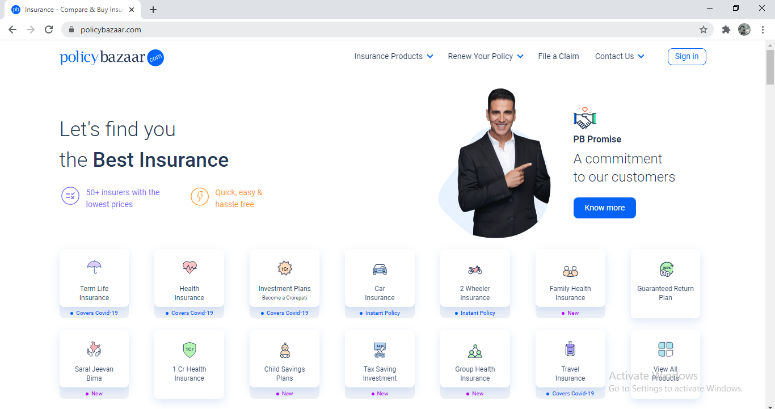
Landing page of policy Bazaar:

Slide 7
Work flow to find Three Lowest Travel Insurance Plans:
Launch Browser
Fill all the details(Destination, Age, Trip dates etc)
Open PolicyBazaar.com
Click on Get Free quotes
Open Travel Insurance
Select Low to High in Sort By Option
Select Student Phase
Display Three Lowest International Travel Insurance plans

Slide 8
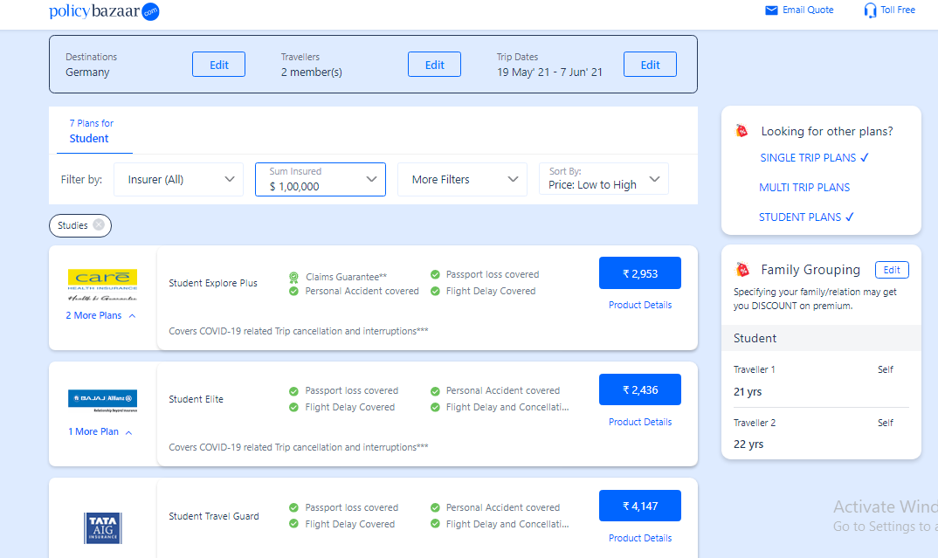
Three Lowest Travel Insurance Plans

Slide 9
Work flow for Car Insurance
Launch Browser
Fill all the Details
Open PolicyBazaar.com
Invalid Email or Phone number should be given
Open Car Insurance
Capture the Error Message
Click on Proceed without Car Number

Slide 10
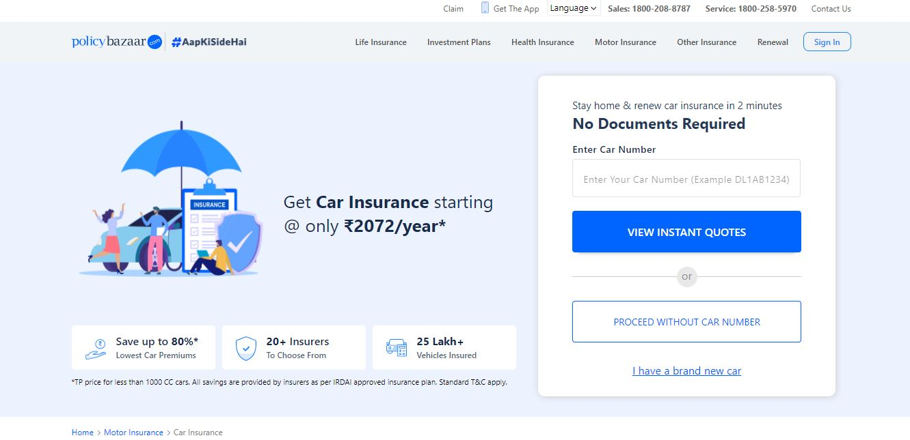
CAR INSURANCE

Slide 11
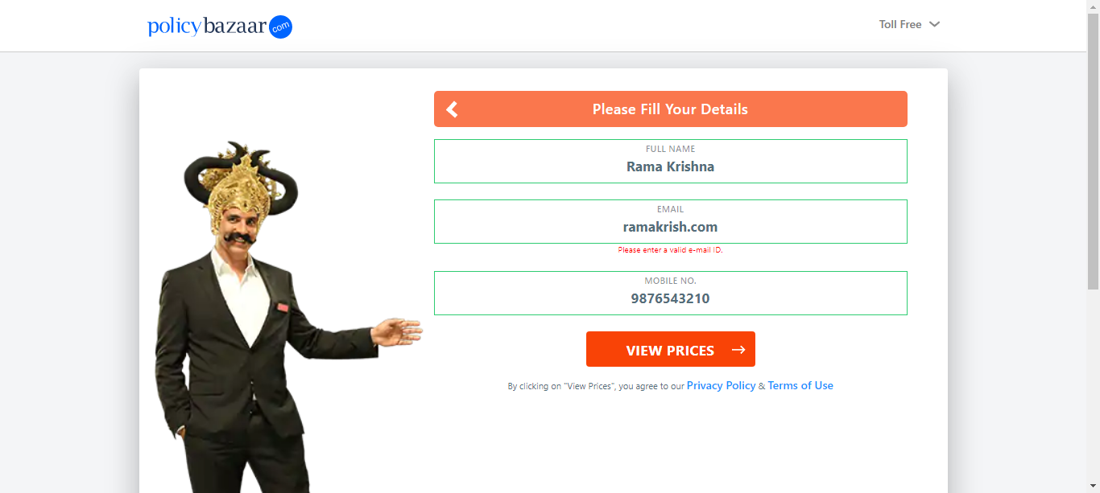
ERROR MESSAGE

Slide 12
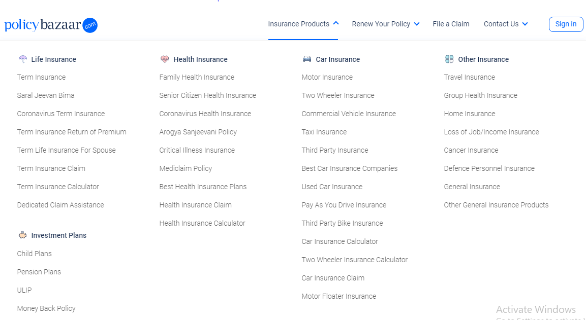
HEALTH INSURANCE

Slide 13
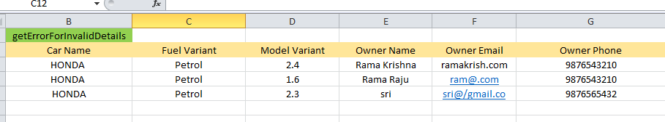
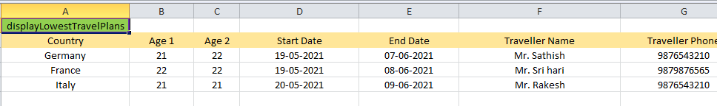
TEST DATA

Slide 14
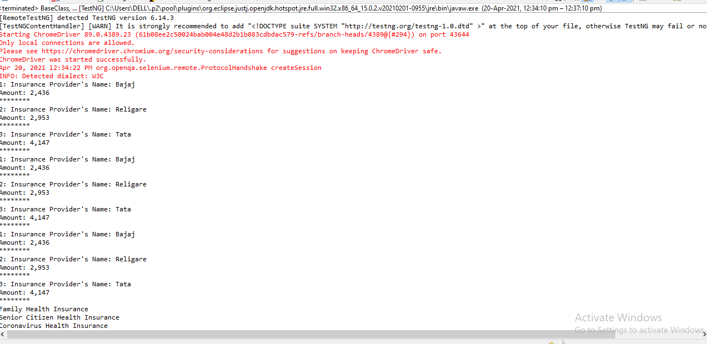
OUTPUT FROM CONSOLE

Slide 15
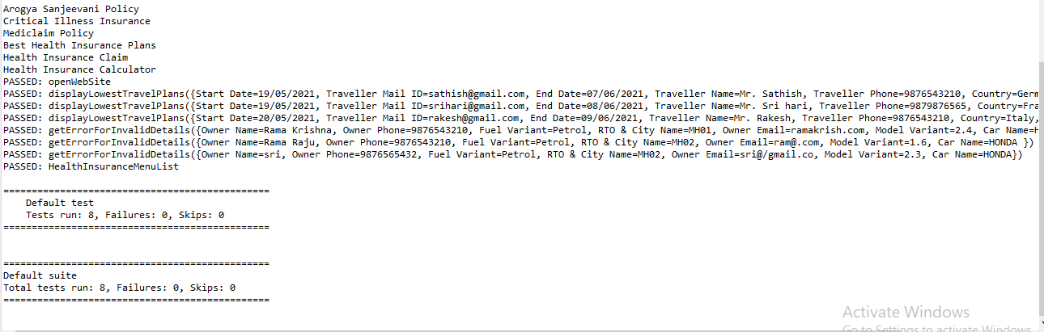

Slide 16
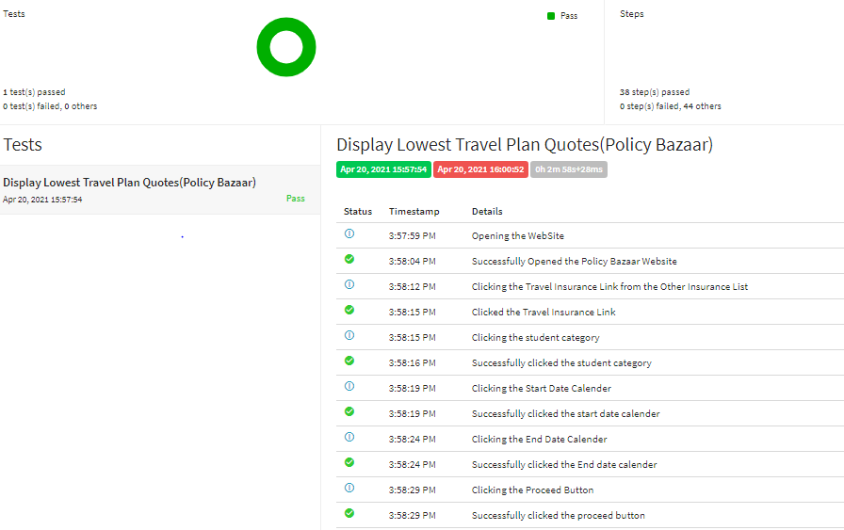
REPORT

Slide 17
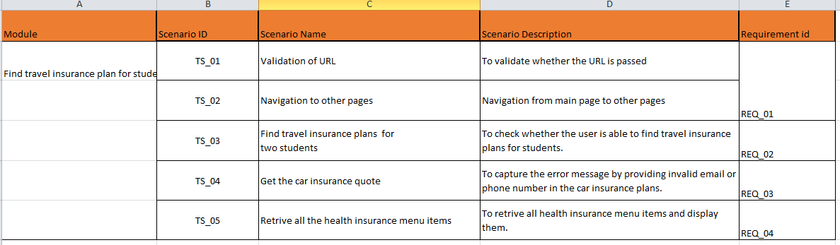
FUNCTIONAL TEST CASES

Slide 18
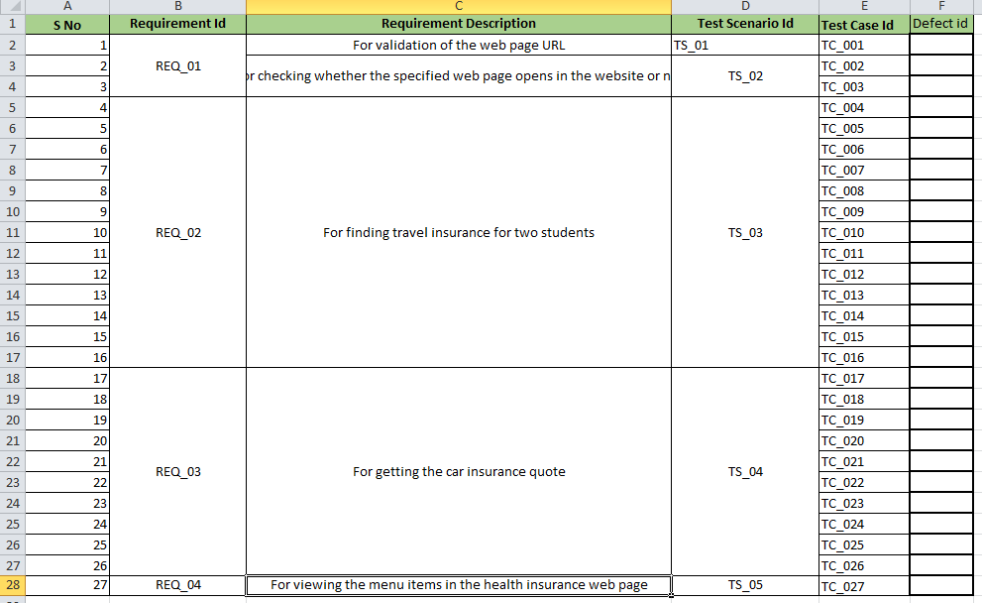

Slide 19


